Slide 1
Ministry of Higher education and Scientific Research University of Diyala /College of Engineering Department of Chemical Engineering
Citric acid production plant Design
تصميم معمل لانتاج حامض الستريك
Prepared By:
Ahmed Saleh
Mahdi Hussein
Qutoof Khaleel
Supervised By
Dr. Salah N. Farhan

Slide 2
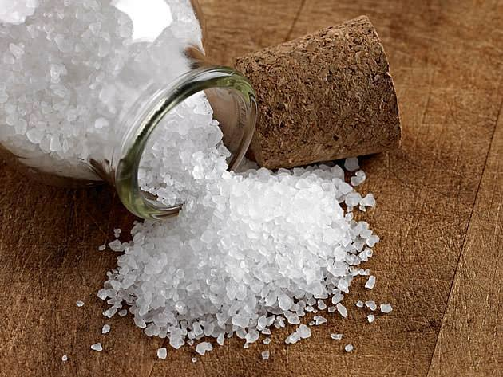
Introduction
Citric acid (C6H8O7) is tricarboxylic acid and it is an organic acid and is less reactive than sulfuric or hydrochloric acid , thereby being somewhat safer to handle.
Citric tricarboxylic acid , it is also known as B-hydroxytricarballylic acid .
Aim of study:
The aim of this current work is to prepare citric acid by fermentation method and design all unit operation related to this project .

Slide 3
Abstract
This project for production of citric acid from sucrose and dextrose. It is an organic compound formula (C6H8O7) and lower effectiveness of sulfuric acid and hydrochloric acid .The estimated percentage consumed in the food industry by about 60% ,where it enters in soft drinks, fruit juice , jams and conserved food , as the proportion of consumption in the pharmaceutical industry is estimated at about 10%, 30% in other chemical industries such as leather tanning and textile industry and the industry of dyes and inks and deposition electrical and remove rust and industry mirrors .
It is known that the world needs from citric acid fermentation provided by roads which account for around 99% of total production while the extraction of citrus ways to provide about 1% of the world's needs of acid .
Estimated production capacity is 50,000 tons per year is equivalent to 6944.6 Kg per hour and the equivalent of 36.17 K Mol per hour.

Slide 4
Properties
physical properties
Citric acid, anhydrous, crystallizes from hot aqueous solution as colorless translucent crystals or white crystalline powder. Its crystal form is monoclinic holohedra . Citric acid is deliquescent in moist air.
Citric acid (C6H8O7)

Slide 5
Chemical properties
Citric acid undergoes most of the reaction such as:
Decomposition.;
When heated above 175 C , citric acid decomposes to form aconitic acid, citraconic acid, itaconic acid , acetonedicarboxylic acid , carbon dioxide , and water
Esterification.
Citric acid is easily esterified with many alcohols under azeotropic condition in the presence of a catalyst such as sulfuric acid, p-toluene-sulfonic acid, or sulfonic acid-type ion-exchange resin. Alcohols boiling above 150C esterify citric acid without a catalyst
Oxidation.
Citric acid is easily oxidized by a variety of oxidizing agents
Such as peroxides, hypochlorite, persulfate, permanganate, periodate, hypobromite , cheomate , manganese dioxide, and nitric acid. The products of oxidation are usually acetonedicarboxylic acid, oxalic acid, carbon dioxide, and water .

Slide 6
●Production Method
1-laboratory synthesis
2-Early production
3-Fermentation
A-surface fermentation
B- submerged fermentation
4-other fermentation
Process chosen
The process chosen is submerged fermentation

Slide 7
Application of Citric Acid:
1- Acidulate in food, confectionary, and beverage (75%)
اعطاء حموضة للاغذية والحلويات والمشروبات ونسبة الاستخدام 75%
2- Pharmaceutical (10%), e.g. soluble aspirin preparation
الصناعات الدوائية مثل الاسبرين و نسبة الاستخدام 10 %
3-industrial (15%): complexes with metals such as iron and copper to be stabilizer of oil and fats.
استخدامات صناعية مثل تكوين معقدات مع ايونات المعادن مثل الحديد والنحاس لتثبيت الزيوت والدهون

Slide 8
Application of Citric Acid:
4- Citric acid and its sodium or potassium salts are used in:
حامض الستريك و املاحه تستخدم كذلك في:
a- many food products including carbonated beverages dry-packaged drinks fruit drinks and jams.
العديد من المنتجات الغذائية بما في ذلك المشروبات الغازية والمشروبات المعبأة الجافة والمربيات
b- in producing vegetable oils
في إنتاج الزيوت النباتية
c- in preserving the color, flavor, and vitamin content of fresh and frozen vetables and fruit.
في الحفاظ على اللون، والنكهة، ومحتوى الفيتامينات من الخضار والفواكه الطازجة والمجمدة.
d- in cleaning e.g., for boilers and heat exchanger.
في التنظيف على سبيل المثال، للمراجل والمبادلات الحرارية.

Slide 9
Application of Citric Acid:
e-employed as a detergent builder ,especially in liquid formulations.
يستعمل لتحضير المنظفات، وخاصة في التركيبات السائلة.
f- it is solutions can remove sulfur dioxide from gases
محاليله تستخدم لازالة ثاني أوكسيد الكبريت من الغازات
g-reduces PH and remove calcium to pretreated or remedy cement contamination.
تقليل الدالة الحامضية وازالة الكالسيوم
h- sequesters soluble iron to prevent polymer cross linking
عزل الحديد الذائب ومنع التشابك في صناعة البوليمرات

Slide 10
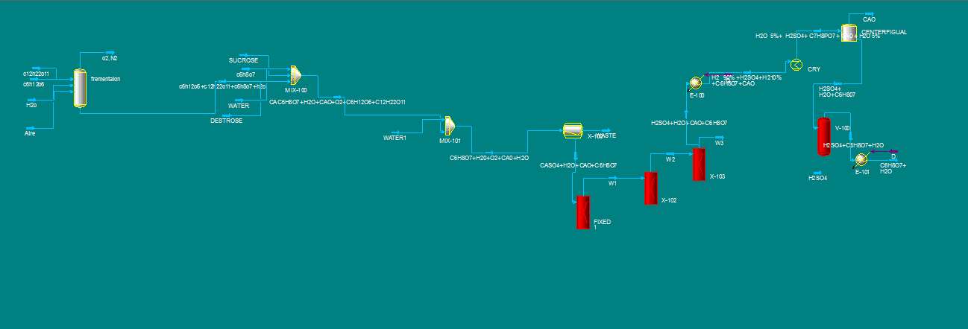
Process Flow Sheet

Slide 12
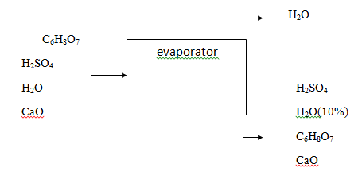
Material balance
material balance on evaporator
Stream No | IN |  | OUT |  | OUT
Component flow rate | Kg/hr | Kmol/hr | Kg/hr | Kmol/hr | Kg/hr | Kmol/hr
Citric acid | 6944.64 | 36.17 |  |  | 6944.64 | 36.17
Water | 685.28 | 38.071 | 616.752 | 34.264 | 68.526 | 3.807
Lime slurry | 3038.56 | 54.26 |  |  | 3038.56 | 54.26
Sulfuric acid | 3544.66 | 36.17 |  |  | 3544.66 | 36.17
Total | 14213.14 | 164.671 | 616.752 | 34.264 | 1359.386 | 130.407

Slide 13
Material balance on centrifugal
Stream No | IN |  | OUT |  | OUT
Component flow rate | Kg/hr | Kmol/hr | Kg/hr | Kmol/hr | Kg/hr | Kmol/hr
Citric acid | 6944.64 | 36.17 |  |  | 6944.64 | 36.17
Water | 34.263 | 1.9035 |  |  | 34.263 | 1.9035
Lime slurry | 3038.56 | 54.26 | 3038.56 | 54.26
Sulfuric acid | 3544.66 | 36.17 |  |  | 3544.66 | 36.17
Total | 13562.12 | 128.503 | 3038.56 | 54.26 | 10523.56 | 74.2435

Slide 14
ENERGY BALANCE
ENERGY BALANCE ON EVAPORATOR
Stream number | Component | Temperature C ̊ | ∆H ̊ (J/hr)
Stream in | C₂H₈O₇, H₂O, CaO, H₂SO₄ | 25 | 0.0
Stream out | H₂O (9%) | 110 | 1.4904*10⁹
Stream out | C₂H₈O₇, H₂O(10%), CaO, H₂SO₄ | 110 | 73.66*10⁹

Slide 15
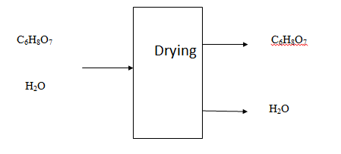
ENERGY BALANCE ON DRYER
Stream number | component | Temperature C ̊ | ∆H ̊ (J/ hr)
STREAM IN | C₆H₈O₇ , H₂O | 25 | 0.0
STREAM OUT | C₆H₈O₇ | 100 | 1.338*10¹⁰
STREAMOUT | H₂O (10%) | 100 | 9.644*10⁶

Slide 16
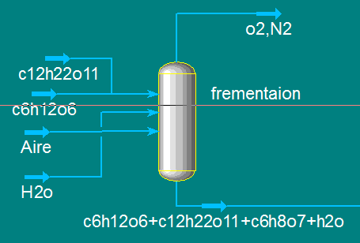
Design Consideration
We are Currently working on units design including fermentor and separation units.
1-fermenter

Slide 17
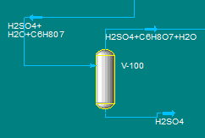
2- separator

Slide 18
For fermentor
For separator
Diameter(m) | Height(m) | Volume (m3) | equipment
1.167 | 0.915 | 1.25 | fermentor
Diameter( ft) | Height( ft ) | equipment
3.3 | 10 | separator

Slide 19
. Environmental Effect from the production of citric acid
The production of citric acid by fermentation in a manner of eco-friendly, in this way not need to burn oil products in recent years tended to global industry production biogenic ways to preserve the environment and reduce harmful emission.
The negative implecations that the project on the pollution of the environment by launching the industrial waste such as clays calcium oxide despite the percent of the clays calcium oxide is low can be landfilled in the ground and calcium oxide can be retrieved and thus reduce the economic cost of the project, suggest create calcium oxide recovery unit, which consists of center fugal filtration to reject the solid waste and then passes the output to the evaporator where the water is reject as vapor. Where it is obtained calcium oxide crystal for reuse.

Slide 20
References
1--(wikipedia.).
2- Kirk and Othmer,”Encyclopedia of Chemical Technology” (vol.27),4th Ed.
3-. Ullmann

